Slide 1
HEART DISEASE
Nazma Khatoon

Slide 2
Index No. | Title | Page No
1 | Introduction | 3
2 | Objective | 4
3 | Data Sharing Agreement | 5
4 | Insights | 6
5 | MY DESION | 7,8

Slide 3
INTRODUCTION
Heart disease is a pervasive global health challenge, demanding early and precise diagnosis. Leveraging advancements in medical technology and data analytics, this study explores a holistic diagnostic approach. Integrating diverse datasets, including medical records and genetic information, our aim is to develop a comprehensive framework using AI and machine learning. By addressing challenges such as personalized diagnostics and multi-modal data integration, we strive to contribute to the evolution of tailored strategies. Ultimately, this analysis seeks to usher in a new era of precision medicine for heart diseases, enhancing diagnostic accuracy, improving patient outcomes, and fostering proactive and personalized cardiovascular care.

Slide 4
OBJECTIVE
1. Increase awareness about heart disease risk factors and prevention methods through community outreach programs, workshops, and educational campaigns.
2. Implement regular health screenings and check-ups in underserved areas to detect early signs of heart disease and provide timely interventions.
3. Collaborate with local healthcare providers to ensure access to affordable cardiac care and medications for individuals at high risk of heart disease.
4. Promote healthy lifestyle choices such as regular exercise, balanced diet, smoking cessation, and stress management to reduce the prevalence of modifiable risk factors contributing to heart disease.
5. Evaluate the effectiveness of intervention programs through data collection and analysis, tracking changes in heart disease incidence rates and monitoring improvements in community health outcome

Slide 5
DATA SHARING AGGREMENT
File Name : Heart Disease.csv
Dataset Size : 11.0KB
Number of Rows: 304
Number of columns: 14

Slide 6
INSIGHTS
Cholestoral , Blood Pressure and Heart Disease
Cholestoral , Blood Pressure, Heart Rate
Heart Disease by Gender

Slide 7
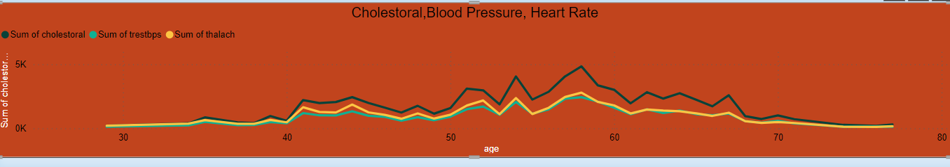
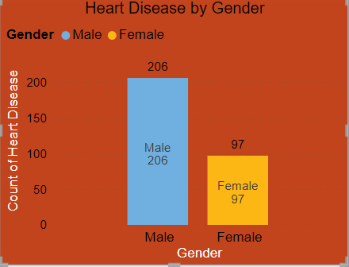
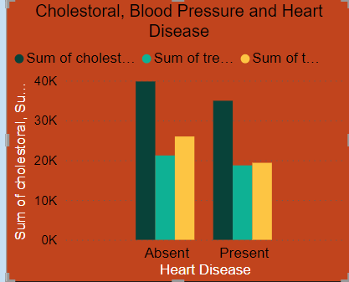
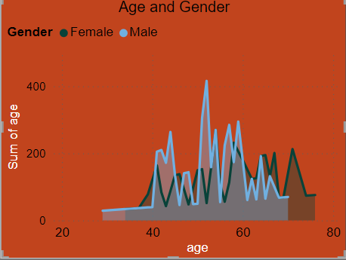
MY DESIGN

Slide 8
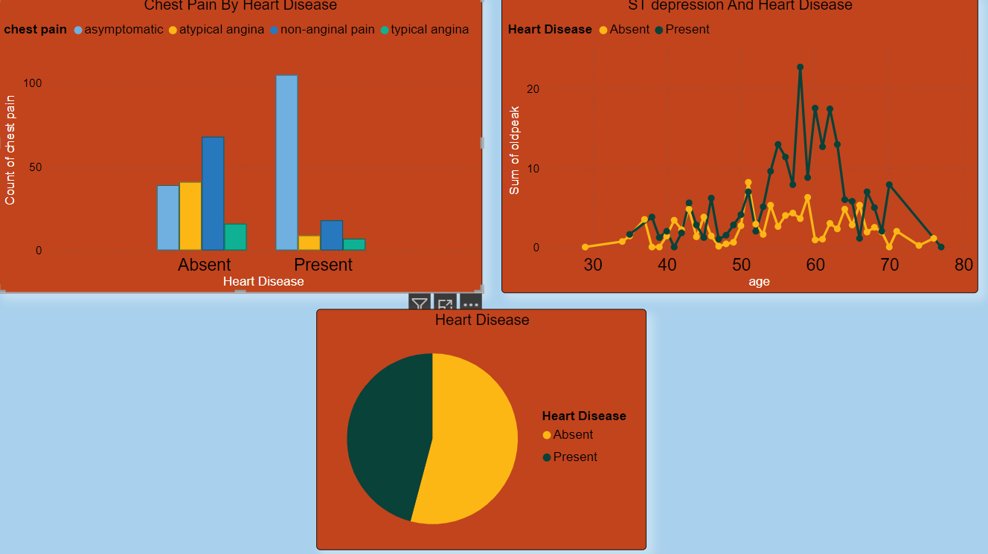

Slide 9
THANK YOU

